Slide 1

VODAFONE UK UPSELL

Slide 2
Problem Definition:
Vodafone UK would like to segment the customers to upgrade the probable customers with higher bandwidth internet connect connection.Vodafone would like to find out the customers so that they can target well for getting higher conversion rate and reduces marketing budget.

Slide 3
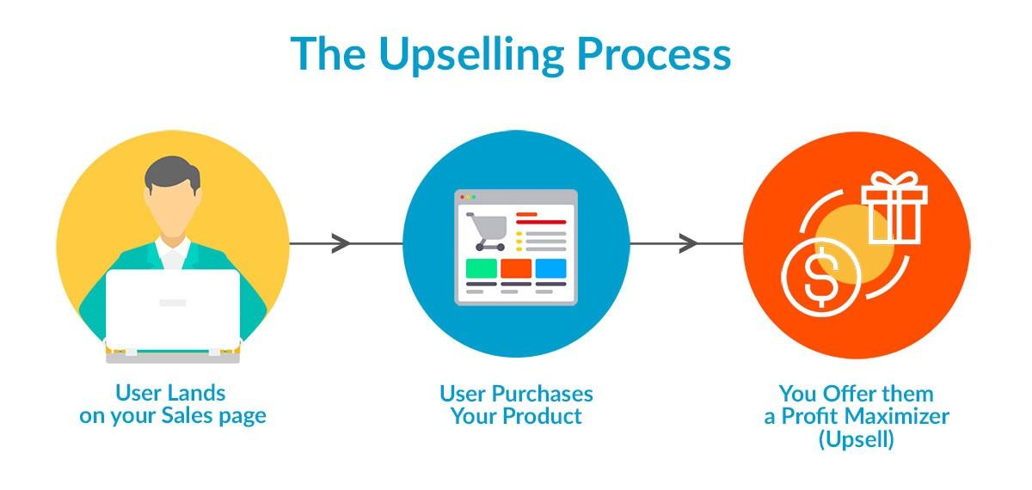

Slide 4
Assessing the problem:
Complication:
Client(Vodafone) is unable to identify the customers who would wish to upgrade their plans.
Current situation:
Customers are not aware of the plans that would suit them better and satisfying.
Desired state:
Client will be able to identify their customer and help them upgrade their plans there by, satisfying their customer needs and reducing their marketing budget.

Slide 5
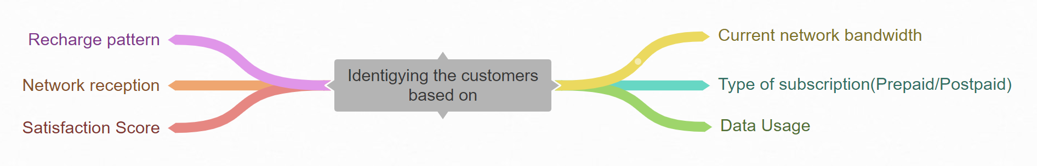
Factors involved in identifying the customers:

Slide 6
Categorising the customers:
Good satisfaction score
Good N/W reception
Data Usage
N/W bandwidth
Recharge pattern
Prepaid
Postpaid

Slide 7

THANK YOU

